Slide 1
Automating the classic snake game
Reinforcement Learning - Project Presentation
🐍

Slide 2
Table of Contents
Theory (Q-learning)
Game Framework
01
02
Implementation
Alterations made to the game
03
04
Understanding Q-Learning
Understanding how the game works.
Simulation
Different implementations of the game 🐍

Slide 3
Theory (Q-Learning)
01

Slide 4
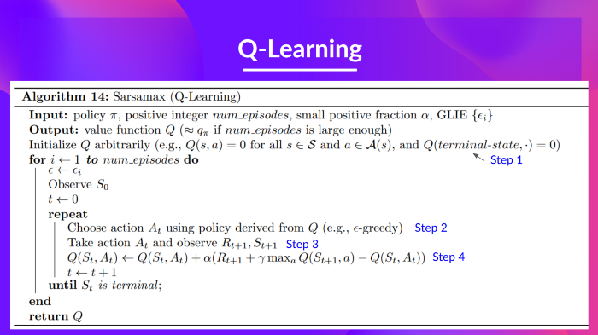

Slide 5
Game Framework
02

Slide 6
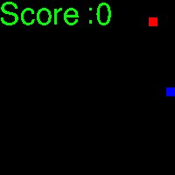
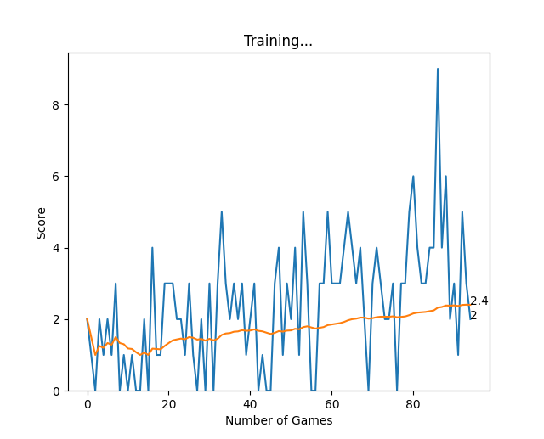
Game Framework
Our aim is to teach the agent, the snake, how to take actions in the environment in order to get maximum cumulative reward.
The actions our agent can take is one step is Go Straight , make left turn or right turn.
In order to get maximum cumulative reward the agent has to reach the food using the shortest path while avoiding obstacles.
Reward : eat food = +10 Dud step = -0.01 Collision = -10
The obstacles here will be the grid boundaries and it’s own body.

Slide 7
Pseudo Code + Components
Reward
Eat food = +10
Game Over = -10
Dud step = -0.01
Action (Depends on current direction)
[1,0,0] -> straight
[0,1,0] -> right turn
[0,0,1] -> left turn
State ( 11 values)
[danger_straight, danger_right, danger_left ],
Direction left, direction right, direction up, direction down,
Food left, food right, food down, Food up
while not game_over:
state=get_state()
action = play_agent(state)
take_action(action)
reward=move_snake()
next_state=get_state() update_qtable(state,action,next_state,reward)

Slide 8
Implementation
03

Slide 9
Alterations
04
Different ways of implementation

Slide 10
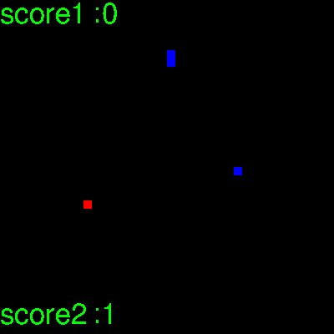
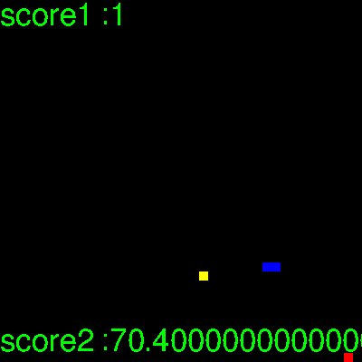
Original Snake
2 Snakes
Snake & Mongoose
The original
Here, both of them try to maximize their individual benefits but if 1 collides it’s game over for both
Original Game + Mongoose trying to eat snake & gets partial reward for eating food

Slide 11
Game Over!
By -
18BCS001 (Aakash Tiwari)
18BCS092 (Yashdeep Shetty)

